Slide 1
Accelerating Systems with Programmable Logic Components Lecture 1 Introduction to the course (2/2)
1DT109 ASPLOC
2023 VT1-VT2
Yuan Yao, yuan.yao@it.uu.se

Slide 2
Why acceleration in HW?
Single-core (pre-2004)
Many-core (homogeneous arch, 2004-2015)
Accelerators (heterogeneous arch, 2015-now)
Determined by the following three “laws”
Moore’s law
Dennard scaling
Pollack’s rule

Slide 3
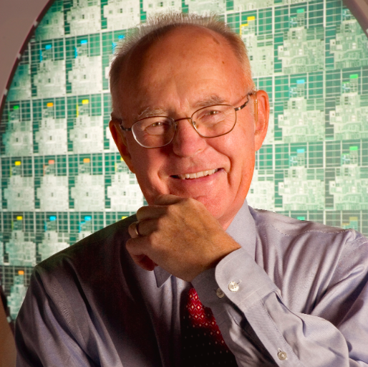
Moore’s Law

Slide 4
Moore’s Law
Moore's law is the observation that the number of transistors in a dense integrated circuit (IC) doubles about every two years.
Gordon E. Moore, “Cramming More Components onto Integrated Circuits”, Electronics, pp. 114–117, April 19, 1965.

Slide 5
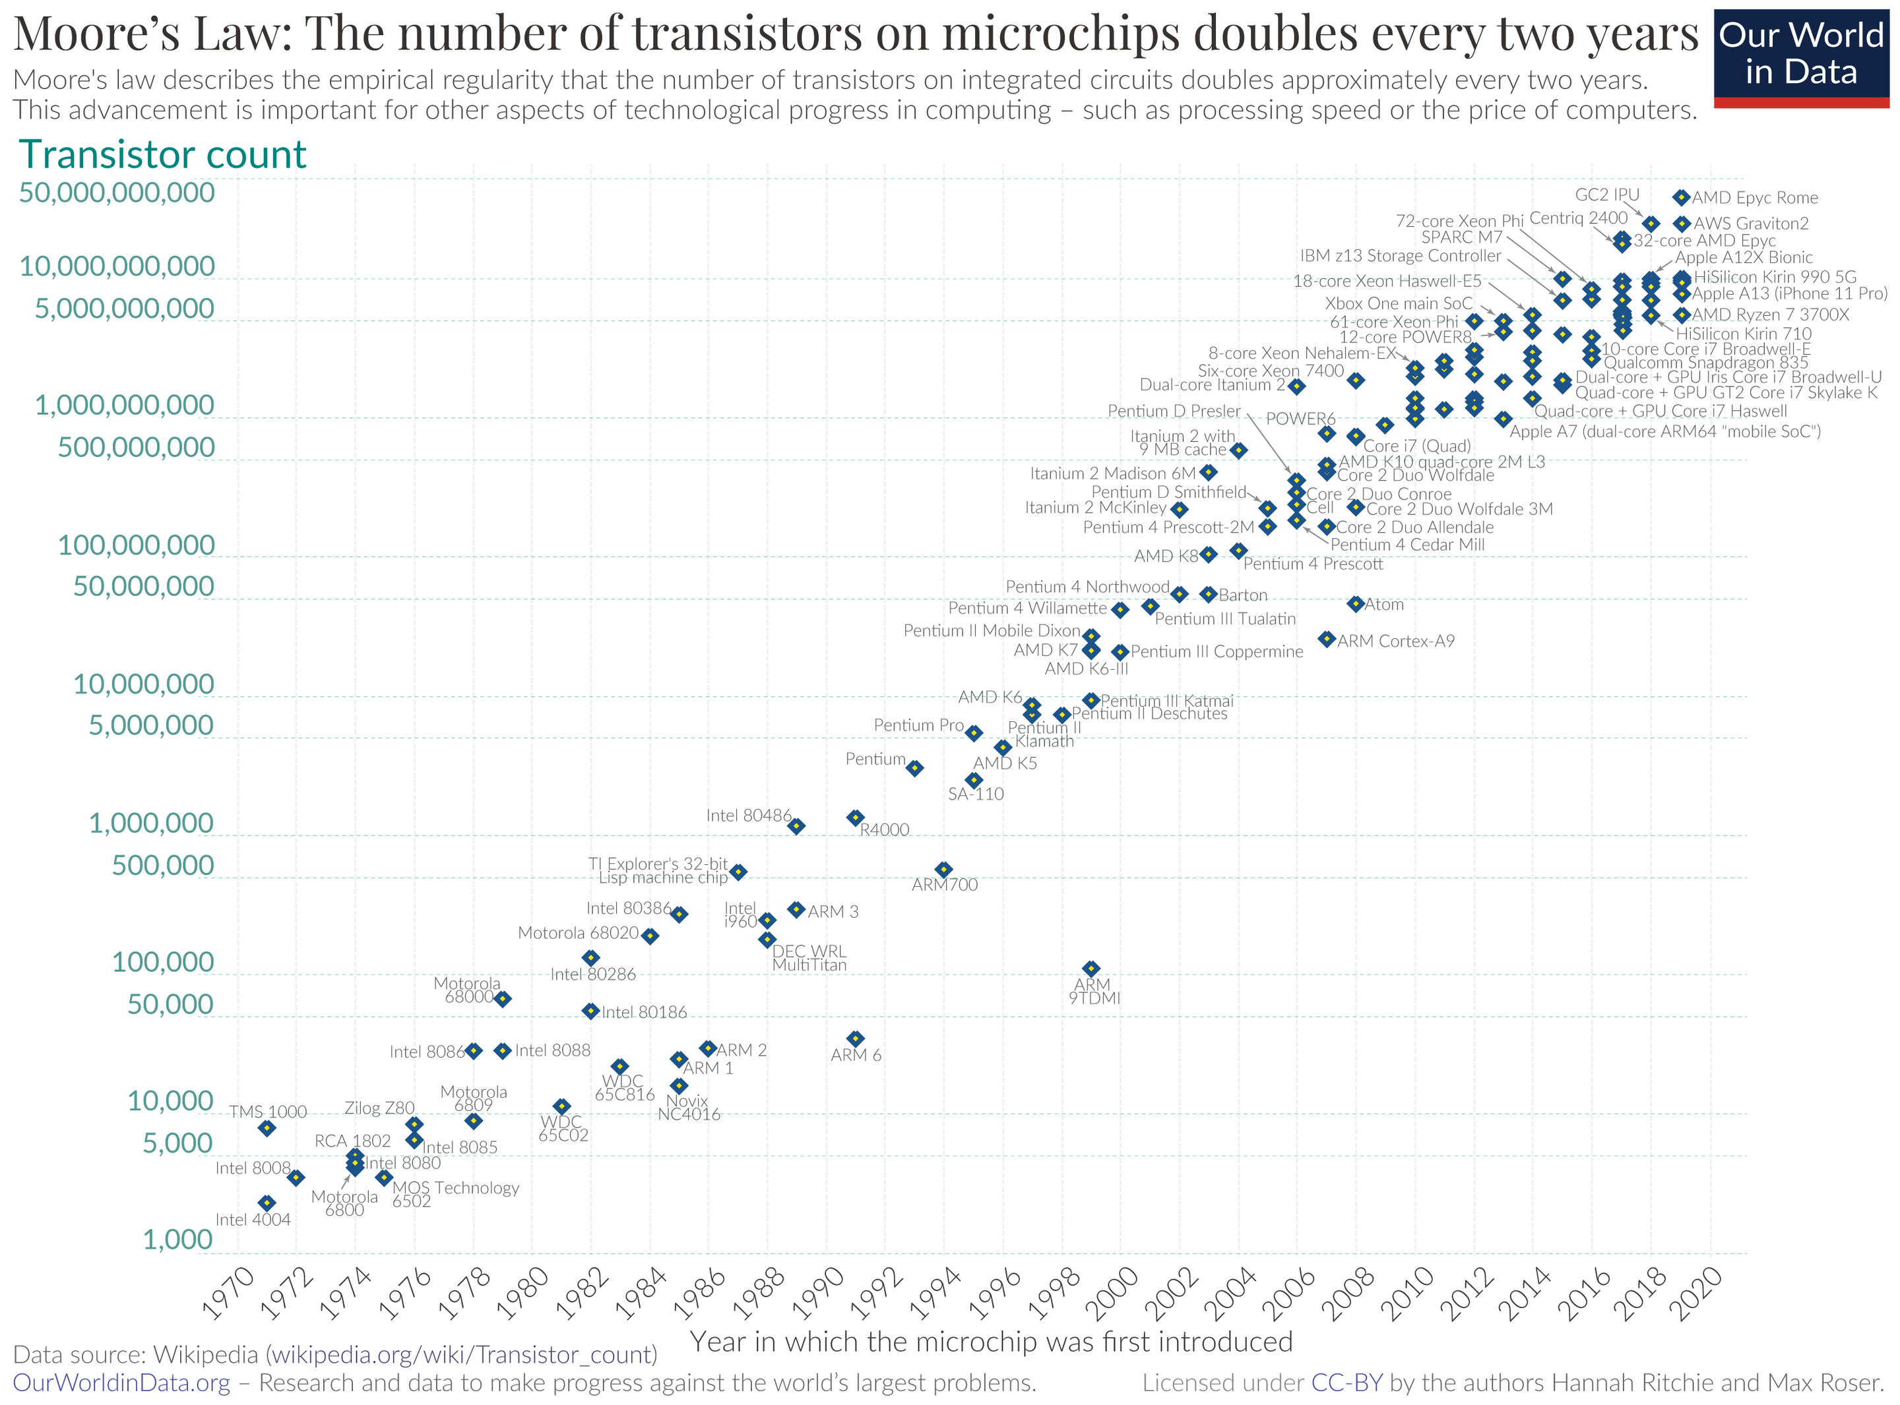
Moore’s Law
Moore's law is the observation that the number of transistors in a dense integrated circuit (IC) doubles about every two years.
Gordon E. Moore, “Cramming More Components onto Integrated Circuits”, Electronics, pp. 114–117, April 19, 1965.

Slide 6
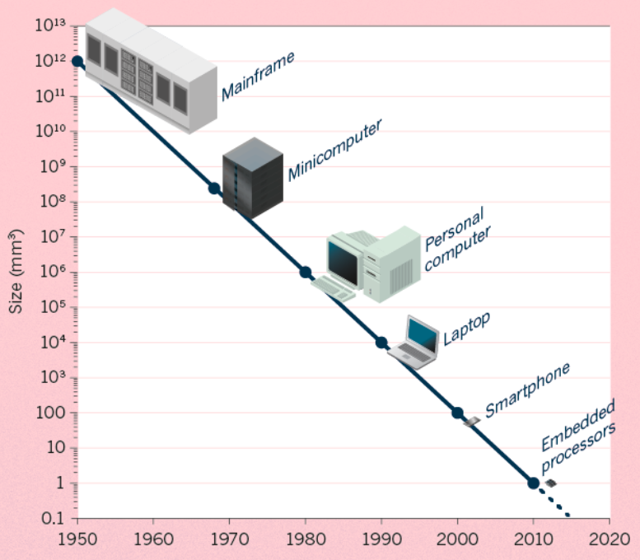
Where do we spend those additional transistors?

Slide 7
Intel processors over 20 years
Why is this phenomenon happening?

Slide 8
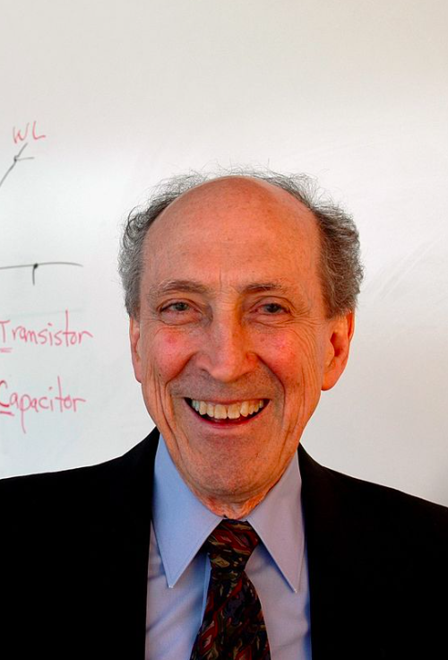
Dennard scaling (MOSFET scaling)

Slide 9
Dennard scaling (MOSFET scaling)
In every technology generation the transistor density doubles, the circuit becomes 40% faster, and power consumption (with twice the number of transistors) stays the same.
Dennard, Robert H.; Gaensslen, Fritz; Yu, Hwa-Nien; Rideout, Leo; Bassous, Ernest; LeBlanc, Andre (October 1974). "Design of ion-implanted MOSFET's with very small physical dimensions" (PDF). IEEE Journal of Solid-State Circuits. SC-9 (5).

Slide 10
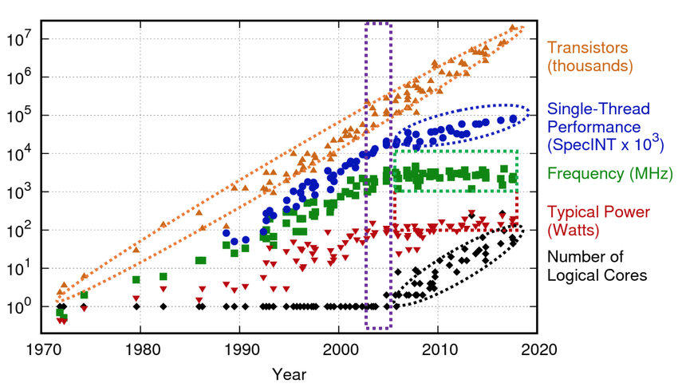
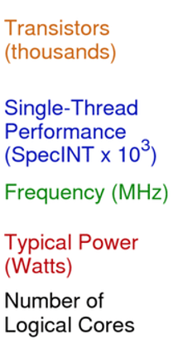
Dennard scaling (MOSFET scaling)

Slide 11
The end of Dennard scaling
Can not keep everything in the same area any longer.
Too hot to handle.

Slide 12
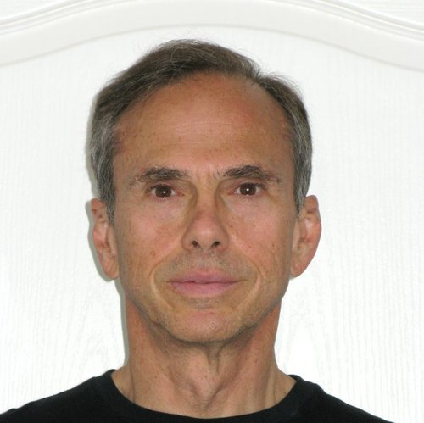
Pollack’s rule

Slide 13
Pollack’s rule
Microprocessor’s performance grows with the square root of area (power, proportional to area).
Microprocessor’s performance increase due to microarchitecture advances is roughly proportional to the square root of the increase in complexity, which is roughly linear to power.
Performance efficiency!!!
F. Pollack, “New Microarchitecture Challenges in the Coming Generations of CMOS Processing Technologies,” in Keynote Speech in the 32nd International Symposium on Microarchitecture (1999)

Slide 14
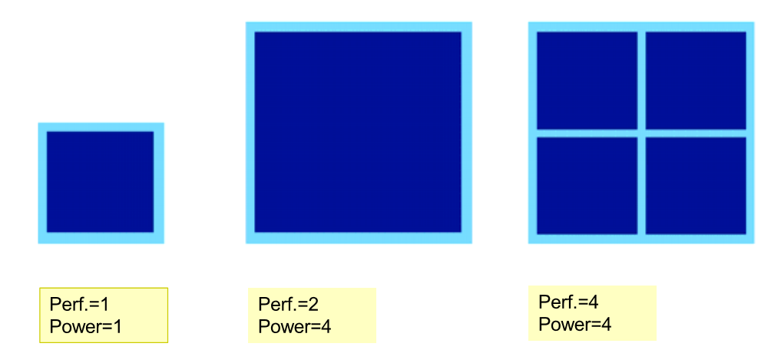
Why multi-/many-core
Performance efficiency (performance per Watt).
2
1
1
The end of Dennard scaling gives birth to the trends of Single-core to Multi-core
1
1
1
2
1
1
1
1
1

Slide 15
But still, why multi-core to heterogenous arch (accelerators)?

Slide 16
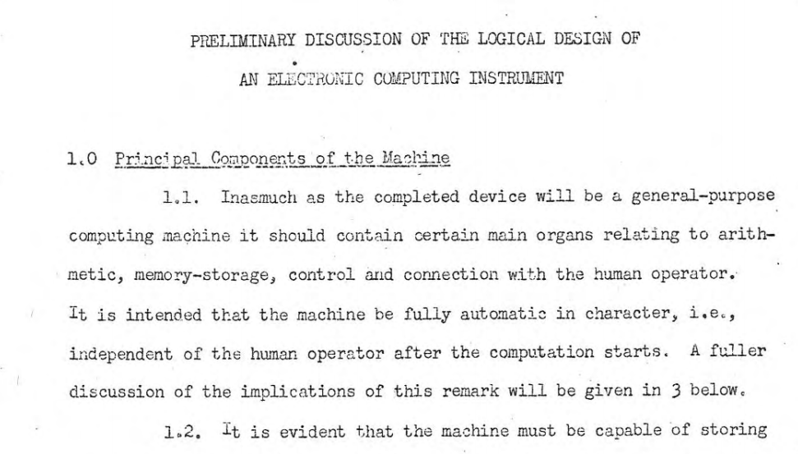
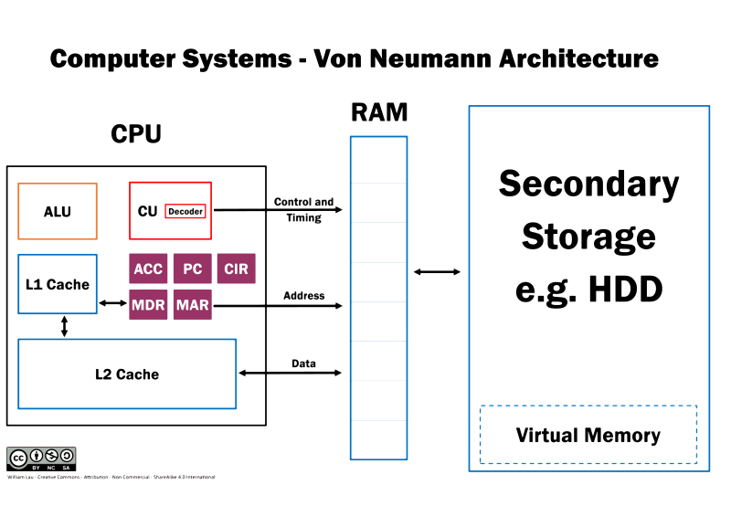
A Computer System
Three key components [Burks et al. 1946]:
Computation
Storage/memory
Communication
Arthur W. Burks, Herman H. Goldstein, John von Neumann, “Preliminary discussion of the logical design of an electronic computing instrument,” 1946.
Notes:
So what causes those problems.
And why data movement is more important and pertinent to performance today?
To understand this question
We should critically re-think how our computing
System stores data and do its computation.
Interestingly, although our computers are becoming
Faster, smaller, with increasing number of cores,
Its underlying structure remains basically the same as its
First introduction by Von Neumann in his 1946 article.
That is, we have three key components in our computing systems
A component to compute, that is our CPU
A component to store data, that is our memory/disk
And a component to connect all the parts together, that is the interconnection fabric.
On this architecture, in order to compute, our cpu needs to fetch data through the memory hierarchy,
And even go to storage when necessary (such as a page fault).

Slide 17
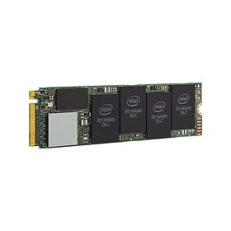
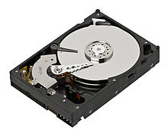
Processor-Centric Computer Systems
Multiple on-chip cores
L2 cache
L3 cache
NoC
On-Chip mem controller
Off-Chip memory
Storage system
Data movement dominates system performance.
Notes:
So what has happened to this architecture during the past years?
During the past few decades, Moore’s law and Dennard’s Scaling drive us to
Put more and more things into this framework.
And this framework becomes busier and busier.
For example.
We can have multiple on-chip cores
Each core can have a slice of shared/private L2 cache
And there will be shared L3 cache, too.
We have our interconnection network to connect these components together
So that cores can load/store data to the caches.
We also need to communicate to the off-chip memory.
For that, we need on-chip memory controllers.
And we can attach off-chip memory ranks to those on-chip memory controllers.
And we still have our storage media.
Now here comes the interesting thing.
On this picture, you may already notice that
How the orange color, that is, our memory system
Has outnumbered the blue color, that is, our processors.
However, the processors are still the boss
On this architecture
Because they are the ones that are actively requesting data.
The memory systems, although take up most of the on-chip area,
Can do nothing but passively shuffling data up and down just to feed data to processors for processing.
In summary, on such a processor-centric architecture,
Data movement dominates system performance because
The Processing of data can be performed
far away from where the data reside.

Slide 18
How About Energy Consumption
Under TSMC 45nm tech-node Horowitz [ISSCC’14]
A 32-bit floating-point add: 0.9 pJ (1x),
A 32-bit SRAM cache read-hit: 5 pJ (5.6x),
A 32-bit DRAM memory communication: 640 pJ (710x)!
With new tech-node, the problem is even worse!
Two thirds (Dally [MICRO’19], Boroumand et al. [ASPLOS’18]) of the total system energy is spent on data movement.
Data movement energy
dominates system energy.
Bill Dally, “The Future of Computing: Domain-Specific Accelerators,” Keynote of the 52nd IEEE/ACM International Symposium on Microarchitecture (MICRO), 2019.
Amirali Boroumand, Saugata Ghose, Youngsok Kim, Rachata Ausavarungnirun, Eric Shiu, Rahul Thakur, Daehyun Kim, Aki Kuusela, Allan Knies, Parthasarathy Ranganathan, and Onur Mutlu, “Google Workloads for Consumer Devices: Mitigating Data Movement Bottlenecks,” in Proceedings of the 23rd International Conference on Architectural Support for Programming Languages and Operating Systems (ASPLOS), Williamsburg, VA, USA, March 2018, pp. 316-331.
Mark Horowitz. “Computing’s Energy Problem,” in IEEE International Solid-State Circuits Conference (ISSCC), 2014, pp. 10-14.
Notes:
←------------
So what these numbers mean?
From a high-level understanding, if we have a cache miss and need to go the memory,
We spend about 700 more energy than an on-chip arithmetic operation
With new tech-node, the problem is even worse since DRAM technology scales slower than core technology (the memory wall).
⬅=
This is indeed prometric as …
====================
(Chris: 45 nm technology I double check newer technology, processor takes less energy, but memory takes)
Answer:
The "memory wall" is the growing disparity of speed between CPU and memory outside the CPU chip.
An important reason for this disparity is the limited communication bandwidth beyond chip boundaries, which is also referred to as bandwidth wall.

Slide 19






Workloads Today – Server
In-memory Databases
Apache’s in-memory
computing platform
Graph/Tree Processing
In-Memory Data Analytics
Apache’s unified analytics engine for big data
Datacenter Workloads
Google’s back-end database
Notes:
OK. So. You may wonder and argue, what if my application doesn’t
process that much of data.
If so, data movement is not a problem!
That is a very clever observation.
But let’s see how applications today looks like.
(A teaser, they are giant in terms of data usage)
On today’s server-end computer, typical workloads include:
In-memory databases
Huge amounts of graph/tree processing
In-memory data analytics
And Datacenter workloads from over 500 million monthly active users

Slide 20






Workloads Today – Mobile/Desktop
TensorFlow Mobile
1H
Chrome
Google’s machine learning framework
AI processing core
Google’s web browser
Video Capture
Video Playback
Google’s video codec
Google’s video codec
Notes:
Moreover, even applications on mobile devices
Are data guzzlers today.
For example, on a commercial smart phone,
Typical workloads include
Artificial intelligence workloads consists of hundreds of millions of weights
Multi-tasking web browser where each process is further multi-threaded to do
Rendering, data roaming, etc.
High-throughput real-time video capturing/play-back applications.

Slide 21
Workload Characteristics on Modern CS
Important workloads are data intensive.
They require rapid and efficient processing of large amounts of data.
Since data is increasing, we may generate more than we can process.
We still need to run the data-intensive workloads on processor-centric architecture.
Notes:
We have seen that
Application won’t help us to reduce data movement.
On the contrary, they make it worse.
This is because
⬅
Because most of our software today is written for the von Neumann architecture，
Which is essentially processor-centric.

Slide 22
How to solve the problem?
Using accelerators!

Slide 23
Core idea: Move Logic Close to Data
“Move logic close to data”
Put compute logic close to memory.
Use memory to compute.
To compute,
Send computing requests to the remote compute logic
Get the results back
Compute
Logic
Memory
Processor
Core
Cache
Ctrl.
Request
Reply
Interconnect
Notes:
State-of-the-art works exploit the so-called policy of
“Move logic close to data” towards the direction
Of data-centric architectures.
So let’s see how this works
This include two options:
1, Put compute logic close to memory.
We can deploy special compute logic right besides memory array to reduce the data distance
2, Use memory to compute.
Or we can more directly use memory to compute.
In this architecture, to compute, we
… So instead of depending on the processor
We depend on special logic, or memory itself, to do computation for us.

Slide 24

Move Logic Close to Data – Related Works
Acceleration using heterogeneous architecture (FPGAs or ASIC)
Google’s TPU [1], Nvidia Tesla P100 [2], Google’s Pixel Visual Core (PVC) [3]
Cambricon’s eDRAM based CNN acceleration [4]
Hardware based graph analytic [5]
Processing data where it resides
Processing-in-memory (PIM) [6,7]
Processing-in-storage [8]
Low-latency and low-energy data access
Near-memory acceleration [9]
Intelligent DRAM controller [10]
We have witnessed a large body of research on “Move logic close to data” including
heterogeneous architecture,
processing data where it resides,
low-latency and low-energy data access,
resulting in special hardware solutions.
Notes:
We have witnessed a large body of
research following the “Move logic close to data” trend.
This includes but not restricted to
heterogeneous architecture, (where we deploy special hardware close to memory)
processing data where it resides, (in this category we use memory or even storage to compute)
And lastly, to reduce data movement energy, we have
Low-latency and low-energy data access methods.
As a cost, all these works results in special hardware solutions.

Slide 25
Move Logic Close to Data – References
Norman P. Jouppi et al. “In-Datacenter Performance Analysis of a Tensor Processing Unit,” in Proceedings of the International Symposium on Computer Architecture (ISCA). 2017, pp. 1–12.
NVIDIA Corporation. “Nvidia ® Tesla ® P100: Infinite Compute Power for the Modern Data Center,” 2016.
Jason W, Albert Meixner et al. “The Pixel Visual Core: Google’s Fully Programmable Image, Vision and AI Processor for Mobile Devices,” in Hot Chips. 2018.
Yunji Chen et al. “DaDianNao: A Machine-Learning Supercomputer,” in Proceedings of the International Symposium on Microarchitecture (MICRO). 2014, pp. 609–622.
Tae Jun Ham, Lisa Wu, Narayanan Sundaram, Nadathur Satish, and Margaret Martonosi. “Graphicionado: A High-Performance and Energy-Efficient Accelerator for Graph Analytics,” in Proceedings of the International Symposium on Microarchitecture (MICRO). 2016, pp. 1–13.
Ping Chi, Shuangchen Li, Cong Xu, Tao Zhang, Jishen Zhao, Yongpan Liu, Yu Wang, and Yuan Xie. “PRIME : A Novel Processing-in-Memory Architecture for Neural Network Computation in ReRAM-based Main Memory,” in Proceedings of the International Symposium on Computer Architecture (ISCA). 2016, pp. 27–39.
Junwhan Ahn, Sungpack Hong, Sungjoo Yoo, Onur Mutlu, and Kiyoung Choi. “A Scalable Processing-In-Memory Accelerator for Parallel Graph Processing,” in Proceedings of the International Symposium on Computer Architecture (ISCA). 2015, pp. 105–117.
Roman Kaplan, Leonid Yavits, Ran Ginosar, and Uri Weiser. “A Resistive CAM Processing-in-Storage Architecture for DNA Sequence Alignment,” in IEEE Micro 37.4 (2017), pp. 20–28.
Nam Sung Kim, Deming Chen, Jinjun Xiong, and Wen Mei W. Hwu. “Heterogeneous Computing Meets Near-Memory Acceleration and High-Level Synthesis in the Post-Moore Era,” in IEEE Micro 37.4 (2017), pp. 10–18.
Jamie Liu, Ben Jaiyen, Richard Veras, and Onur Mutlu, “RAIDR: Retention-Aware Intelligent DRAM Refresh,” in Proceedings of the International Symposium on Computer Architecture (ISCA), Portland, OR, June 2012, pp. 1-12.
Notes:
… and we can find all those works appear in top computer architecture
Conferences or transactions …
This indeed manifest that the problem of data movement is becoming
Attractive nowadays.

Slide 26
We are here because …
CPU + Programmable Accelerator (FPGA)
FPGAs are becoming more powerful (density + speed + power)
CPU and FPGA on the same silicon die lead to low-latency communication
High-level hardware programming tools

Slide 27
Summary
Moore’s law, Dennard scaling, Pollack’s rule reflect industrial efforts on how to jam more transistors into silicon die.
Dennard scaling dies 2004, which gave birth to the multi-core era.
Moore’s law becomes less powerful (if not dying). People start to think about how to move data smarter and cheaper using accelerators.
Many ways to do accelerators. We focus on using FPGA in this course.

Slide 28

Questions?

